Slide 1
Pipelining
Applying Henry Ford’s ideas to the CPU

Slide 2

How can we go faster?
Big Idea!
What if each functional area (fetch, dispatch, execute) gets a WHOLE clock tick instead of 1/3 of one?
Then we can make the clock ticks shorter (and the clock rate faster)!

Slide 3
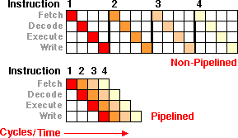
Pipelining
Fetch
IR = Mem[PC]
NextPC = IR + 4
Decode
OP1 = Regs[op1 ] OR Immediate OR Mem[Regs[op1]]
OP2 = Regs[op2 ] OR Immediate OR Mem[Regs[op2]]
Execute
result = ALU
OR
FPU
Store
Mem[rt] = result
OR
Regs[rt] = result

Slide 4

Problem solved, right?
But, wait. What happens if there is a jump/branch/call?

Slide 5
Pipelining
BNE label
ADD R0, R1, R2
MULT R2, R3, R4
label: CALL _printf
Fetch
IR = Mem[PC]
NextPC = IR + 4
Decode
OP1 = Regs[op1 ] OR Immediate OR Mem[Regs[op1]]
OP2 = Regs[op2 ] OR Immediate OR Mem[Regs[op2]]
Execute
result = ALU
OR
FPU
Store
Mem[rt] = result
OR
Regs[rt] = result

Slide 6
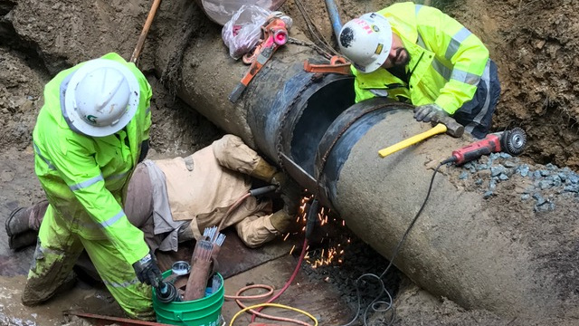
Pipeline Stall
When this happens, the pipeline has to be flushed and refilled.
The CPU sits idle until this completes.

Slide 7
Idle? Pipelines are supposed to make it faster!
They do. They aren’t perfect, though.
Pipeline hazards are situations where the pipeline doesn’t flow perfectly. There are three major types:
Structural Hazards – Resource conflicts such that the hardware cannot keep up
Data Hazards – Data dependencies between pipeline stages
Control Hazards – Branches causing pipeline stalls

Slide 8
How do we resolve this?
The CPU has to check (in hardware, remember) for these conditions.
The “simple answer”:
Structural Hazard – introduce a delay or “bubble” in the pipeline
Data Hazard –introduce a bubble
Control Hazard – flush the pipeline (discard all data) and start over

Slide 9
How do you stall/create a bubble?
Insert “NOP” instructions
Use a “it is OK to continue” signal line (inside the CPU)

Slide 10
Structural
Hazard
  LOAD R1, $12345678
  LOAD R2, $2345678A
  LOAD R3, $34567890
  (Overload the memory controller)
Fetch
IR = Mem[PC]
NextPC = IR + 4
Decode
OP1 = Regs[op1 ] OR Immediate OR Mem[Regs[op1]]
OP2 = Regs[op2 ] OR Immediate OR Mem[Regs[op2]]
Execute
result = ALU
OR
FPU
Store
Mem[rt] = result
OR
Regs[rt] = result

Slide 11
How can we fix this?
Better prediction of what will be needed. If we look ahead at instructions, we can know what they will need and have it ready. When prediction doesn’t work, though, we need to have an interlock and introduce a bubble.
We can make the compiler smarter – it shouldn’t generate these instructions in a row, except as a last resort.

Slide 12
Structural
Hazard 2
  LOAD R1, $12345678
  ADDI #1,R1
  STORE R1,$2345678A
  The load will take a while to execute,
  so the pipeline has to empty.
Fetch
IR = Mem[PC]
NextPC = IR + 4
Decode
OP1 = Regs[op1 ] OR Immediate OR Mem[Regs[op1]]
OP2 = Regs[op2 ] OR Immediate OR Mem[Regs[op2]]
Execute
result = ALU
OR
FPU
Store
Mem[rt] = result
OR
Regs[rt] = result

Slide 13
How can we fix this?
This is another dependency that can be mitigated somewhat by the compiler. Is there ANY other reasonable order of instructions?
Otherwise, the CPU has to introduce a bubble.

Slide 14
Data
Hazard
  ADD R1←R2,R3
  SUB R4← R1,R3
  Decode can’t get the
  data that hasn’t been
  calculated yet
Fetch
IR = Mem[PC]
NextPC = IR + 4
Decode
OP1 = Regs[op1 ] OR Immediate OR Mem[Regs[op1]]
OP2 = Regs[op2 ] OR Immediate OR Mem[Regs[op2]]
Execute
result = ALU
OR
FPU
Store
Mem[rt] = result
OR
Regs[rt] = result

Slide 15
Data Hazards (3 types)
RAW (Read after write)
(flow dependence)
a = b+c
d = a + e
WAR (write after read)
(anti-dependence)
c = a + b
a = d + e
WAW (write after write)
(output dependence)
c = a + b
e = c + d
c = f + g

Slide 16
How do we fix this?
Reorder the instructions IN THE CPU so that there isn’t a collision
Leave the result accessible so that we can use that instead of the data coming from the decode stage (forwarding).
Forwarding means that the register value from the decode section isn’t the actual value – we will leave a value in the execute section, instead. There is another option, which we will cover later.

Slide 17
Control
Hazard
(repeat)
BNE label
ADD R0, R1, R2
MULT R2, R3, R4
label: CALL _printf
Fetch
IR = Mem[PC]
NextPC = IR + 4
Decode
OP1 = Regs[op1 ] OR Immediate OR Mem[Regs[op1]]
OP2 = Regs[op2 ] OR Immediate OR Mem[Regs[op2]]
Execute
result = ALU
OR
FPU
Store
Mem[rt] = result
OR
Regs[rt] = result

Slide 18

More nuanced answers…
For unconditional jumps, detect those early and fill the pipeline appropriately.
For conditionals, predict/guess what will happen and fill the pipeline with the most probable values.
Or, you could do both and only keep the results from the one that is right.

Slide 19
Branch Prediction
MOVE R1 ← #0
top: …
ADDI R1 ← #1
BLE R1,#100,top
Consider the loop above. What’s the best assumption to make about that branch?
Now consider this C code:
void doSomething (char *param) {
if (param == NULL) return;
What’s the best assumption to make about that branch?

Slide 20
Some ideas on how we could predict
Don’t predict:
Assume not taken or assume taken or assume backward are taken, but forward are not.
Compile time
tag branches as rarely taken or almost always taken
either the compiler or the programmer does the “work”
Run time
predict based on the last time
predict based on the last few times
profile the code and use that value

Slide 21
Statistics to the rescue
Assuming branch taken or branch not taken is suboptimal.
Instead, some CPU designers build a small cache into the CPU.
They index the cache by the address of the branch instruction (this has all of the same issues with associativity as memory caching).
Each time the instruction is decoded, they fill the pipeline based on the current state. When the branch actually executes, they update the current state.

Slide 22
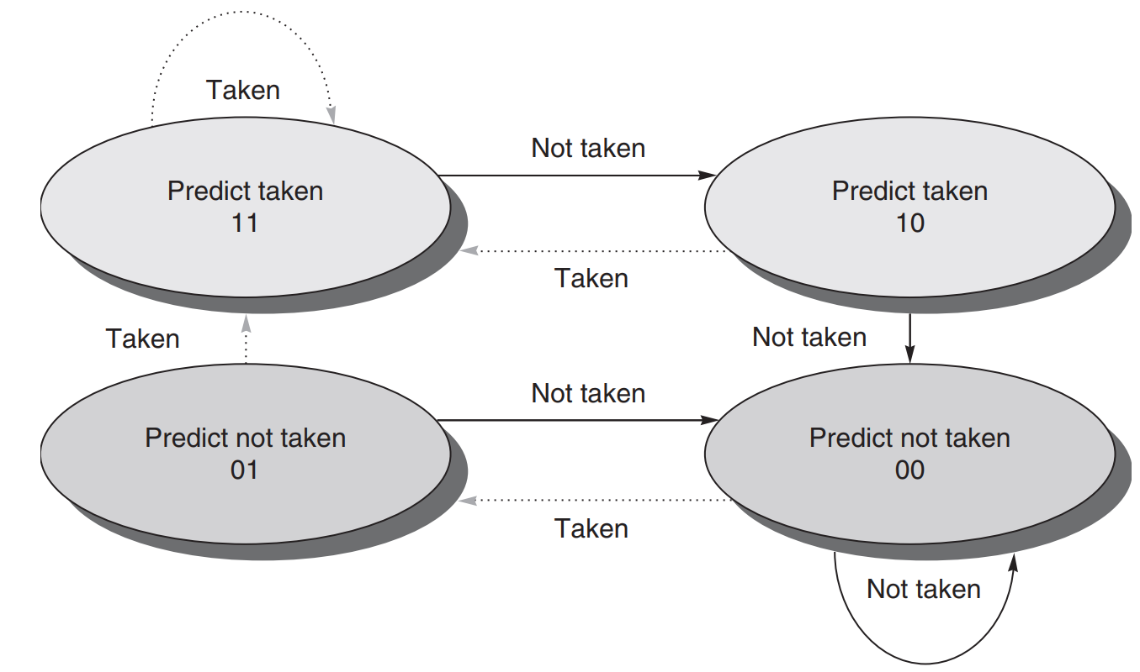
2 bit scheme

Slide 23
What if we guess wrong?
We might have made changes to things that matter, assuming that we will branch one way, but we end up branching the other way and now we have a hot mess.
We can checkpoint – clone all of the registers when we see a branch. We update both the clones and the originals with each instruction. Then when we do (or don’t do) the branch, we just need to pick which set of registers to use!
How do we do this?

Slide 24
Register Renaming
MOVE R1← #1
BNE R2,#5, nochange
MOVE R1 ← #2
nochange: …
What if R1 wasn’t always R1?
Consider the code snippet above. One way to deal with that would be to have another layer of indirection around registers.
If you had, say, 25 registers(call these t0-t24), but only R0-R15 as exposed to the user, you could introduce a table (m) inside the CPU that maps R→t
t[7]←1
t[22] ← 2
m[1] = t[m[2]] == 5 ? 22 : 7

Slide 25
Register Renaming
If you have register renaming, how do you implement
MOVE R2 ← R1
By adjusting the mapping table…

Slide 26
The Free List
Some CPUs have more registers than are externally visible, some do not. Those that do keep a list of the free registers. When all instructions depending on an internal register value are completed, that internal register is added to the free list.
For example:
STORE R1,(R7)
ADD R1 ← R2, R3
R1 has to be kept until the store completes. The CPU takes a temporary register off of the free list and uses that as R1. When the store completes, the temporary serving as R1 is put on the free list.

Slide 27
How do you forward data?
When we talked about data related stalls, we said that we could solve them by forwarding the data.
The way to do that is to use the temporary registers – the CPU can rewrite the instruction to look in the destination register entry instead of the current register mapping.

Slide 28
What about undoing memory changes?
We only have a handful of registers – cloning them via register renaming isn’t too bad. Memory, though, is a lot bigger and slower.
One choice – keep a queue of writes. Once we know that the write should happen (i.e. branch decision is made), commit the write. What happens if we are loading that address, too, though? Each load needs to look at this queue. And remember, most CPUs support byte, 2 byte, 4 byte operations – the address might not be an exact match.

Slide 29
Another Creative Approach
As we will see later, there are two approaches to branching – one style:
BEQ R1, R2, $1234
The other?
CMP R1, R2
BEQ $1234
The mechanism to store the compare status in the second style is called a condition register – bit flags of “is zero, is negative, etc.”

Slide 30
How does this relate to branch prediction?
ARM takes a different approach – branches exist, but almost all instructions execute conditionally based on what is in the condition register. Each assembly instruction has 4 bits (16 possibilities) that indicate when it should execute.
EQ, NE, AL (any),
signed: GT, GE, LT, LE,
unsigned: HI, CS, CC, LS
VS (overflow), VC (no overflow)
MI (negative), PL (positive or zero) (1 of the 16 is reserved)

Slide 31
Branching without branching, exactly…
If you have a program snippet like this:
if (x<0) x++;
In MIPS, it might be:
BLT R0,R1,$x
ADDI R1 ← #1,R1
x: …
In ARM it might compile to:
CMP R1,#0
ADDLT #1, R1
Which one is more pipeline friendly? Of course, there is a cost to this… x86/x64 has this, but for a limited set of opcodes.

Slide 32
Sometimes the language (C) bites us…
if ((a ==5) && (b == 7) && (c != 2))
; /* do something */
C says that the checks on b and c only happen if a==5.
That means that this has to turn into multiple compare/jump combinations.
Because in C, this can be something with side effects:
if ((a == getch()) && (b==d++) && (c = (f &=2))

Slide 33
A blast from the past…
The 680x0 series had a DBRA instruction: decrement and branch
You could specify a register and an address (PC relative)
The CPU would decrement the register, then branch if not 0 to the address.
Very easy to implement and the CPU can predict early whether or not the jump will occur.
Sadly, not implemented on any currently popular hardware.

Slide 34
More complications
So far, we have assumed every instruction takes one clock cycle to execute. What if that wasn’t true (hint – it’s never true)?
What if a hardware interrupt happens in the middle of all of this?
Oh, by the way… 5 stages is a VERY SHORT pipeline. Intel’s Netburst architecture had 31 stages. More modern CPUs have reined that back. 14-20 stages seem to be the sweet spot.

Slide 35
Example: Pentium 4 Architecture
TC Nxt IP: Trace cache next instruction pointer. This stage looks at branch target buffer (BTB) for the next microinstruction to be executed. This step takes two stages.
TC Fetch: Trace cache fetch. Loads, from the trace cache, this microinstruction. This step takes two stages.
Drive: Sends the microinstruction to be processed to the resource allocator and register renaming circuit.
Alloc: Allocate. Checks which CPU resources will be needed by the microinstruction – for example, the memory load and store buffers.
Rename: If the program uses one of the eight standard x86 registers it will be renamed into one of the 128 internal registers present on Pentium 4. This step takes two stages.
Que: Queue. The microinstructions are put in queues according to their types (for example, integer or floating point). They are held in the queue until there is an open slot of the same type in the scheduler.

Slide 36
Example: Pentium 4 Architecture
Sch: Schedule. Microinstructions are scheduled to be executed according to its type (integer, floating point, etc). Before arriving to this stage, all instructions are in order, i.e., on the same order they appear on the program. At this stage, the scheduler re-orders the instructions in order to keep all execution units full. For example, if there is one floating point unit going to be available, the scheduler will look for a floating point instruction to send it to this unit, even if the next instruction on the program is an integer one. The scheduler is the heart of the out-of-order engine of Intel 7th generation processors. This step takes three stages.
Disp: Dispatch. Sends the microinstructions to their corresponding execution engines. This step takes two stages.
RF: Register file. The internal registers, stored in the instructions pool, are read. This step takes two stages.
Ex: Execute. Microinstructions are executed.
Flgs: Flags. The microprocessor flags are updated.
Br Ck: Branch check. Checks if the branch taken by the program is the same predicted by the branch prediction circuit.
Drive: Sends the results of this check to the branch target buffer (BTB) present on the processor’s entrance.

Slide 37
Let the abstraction leak…
Some processor designs have decided not to go to these extreme lengths. Sometimes, by pushing some of the requirements to the machine language programmer, you can make the silicon cheaper/easier/faster.
The next several slides talk about ways to push the problem up.

Slide 38
Load Delay Slots
If there is a load from memory, instead of stalling the CPU, looking ahead or reordering instructions, we could make a rule – the N instruction(s) after a load cannot use the register that is being loaded.
That allows time for the data to come from memory and still lets the CPU get work done.
This pushes the “problem” up the stack to the programmer.
What happens if the same program is run on different machines with different memory load times?

Slide 39

Branch Delay Slots
Instructions already in the pipeline when a branch “hits” are still executed.
MOVE R1←#0
BEQ R7,R8, end
MOVE R2 ←#1
MOVE R3 ← #2
end: MOVE R4 ← #3

Slide 40
Branch Delay Slots with Squashing
OP A
X: OP B
OP C
BEQ X
delay: OP A
OP D
OP E
If the branch is followed, delay’s OP A is in the pipeline and is executed. If the branch is not followed, delay’s OP A is NOT executed. How does this help? How does it not scale?

